Slide 1
Introduction to machine learning
Recap of Session 1
R. Brooks

Slide 2
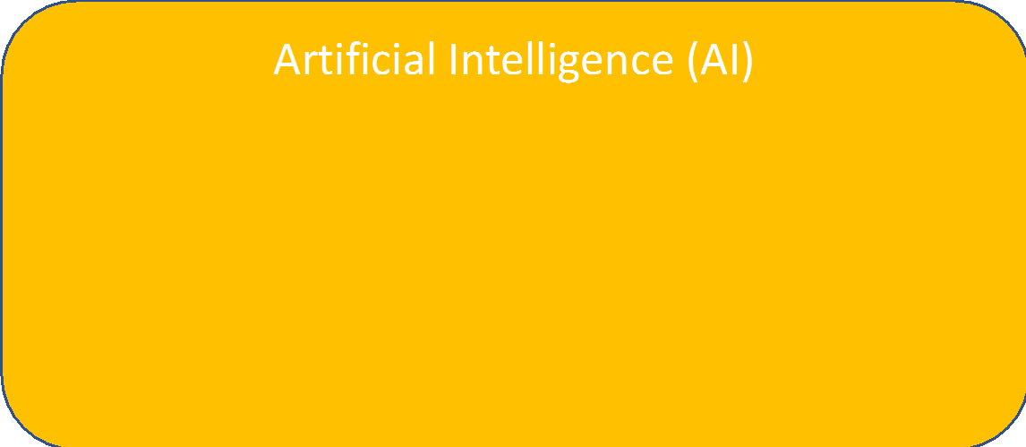
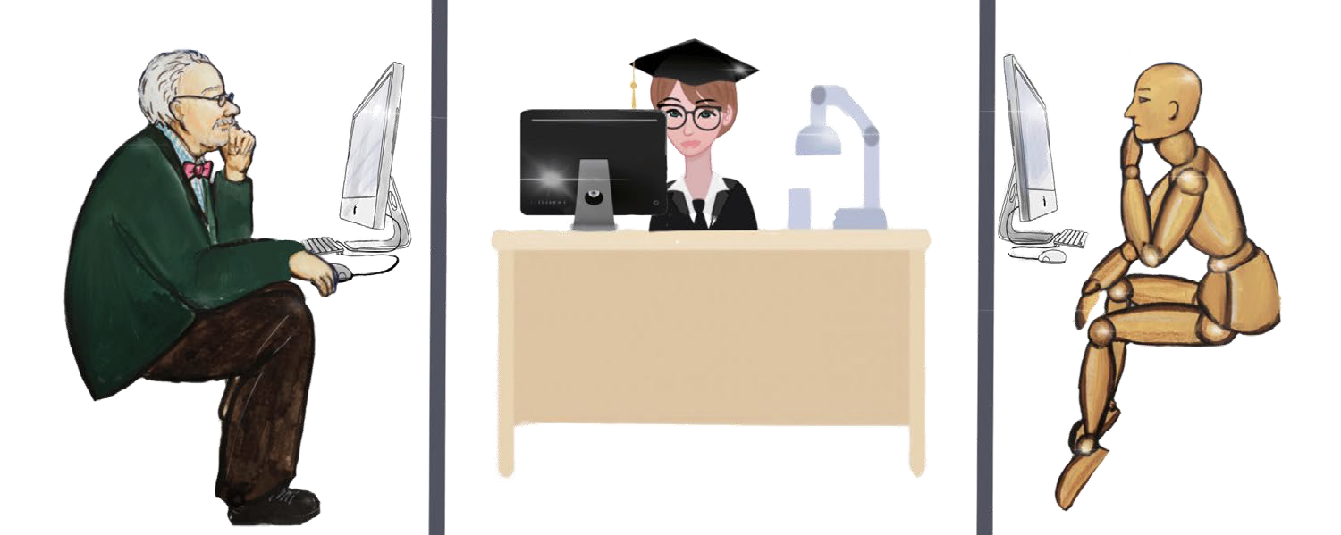
Artificial Intelligence: Roots
Idea is as old as computer science
Alan Turing already proposed an AI test in 1950
Ask a physically remote client questions (human and computer)
If tester cannot distinguish b/w human and computer Turing test passed

Slide 3
Artificial Intelligence: Key Facts
Today, often ML algorithms are referred to when someone talks about AI
Machine learning := pattern recognition through data analysis
Machine Learning (ML)

Slide 4
Artificial Intelligence: Key Facts
Supervised learning := operator defines what to detect and provides input data
Unsupervised learning := algorithms detects what to detect based on input data
Reinforcement learning := actor interacts with environment to maximize reward
Deep learning := great for pattern recognition, but involves significant computing power
Machine Learning (ML)
Supervised Learning
Unsupervised Learning
Reinforcement Learning
Deep Learning

Slide 5
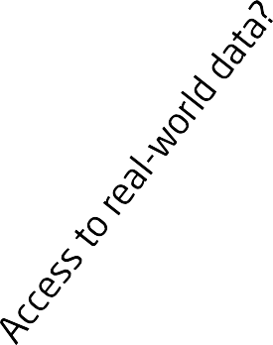
Artificial Intelligence: Key Facts
Real-world Data
Classification, Probability, Prediction
Machine Learning (ML)
Supervised Learning
Unsupervised Learning
Reinforcement Learning
Deep Learning

Slide 6




Using Data to Train Machines
Machine Learning
Tasks
Experience (Training Data)
Training
“Field of study that gives computers the ability to learn without being explicitly programmed”
(Arthur Samuel, 1959)
“A computer program is said to learn from experience E with respect to some
class of tasks T and performance measure P
if its performance at tasks in T, as measured by P, improves with experience E.”
(Tom Mitchell, 1997)
Learning algorithm
Prediction
Performance measure
Goal
Result

Slide 7
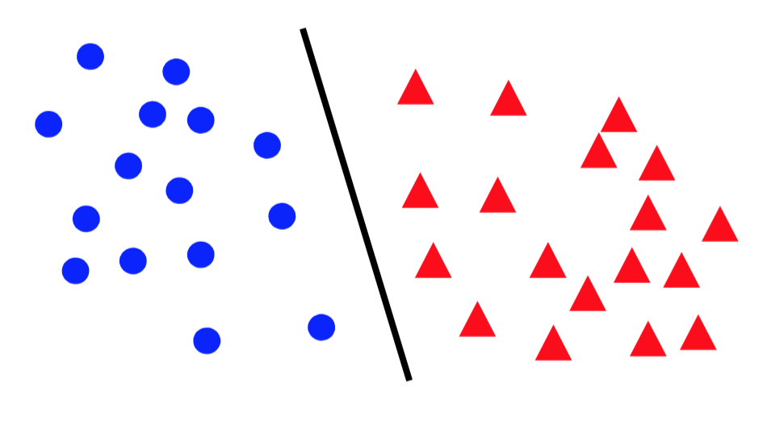
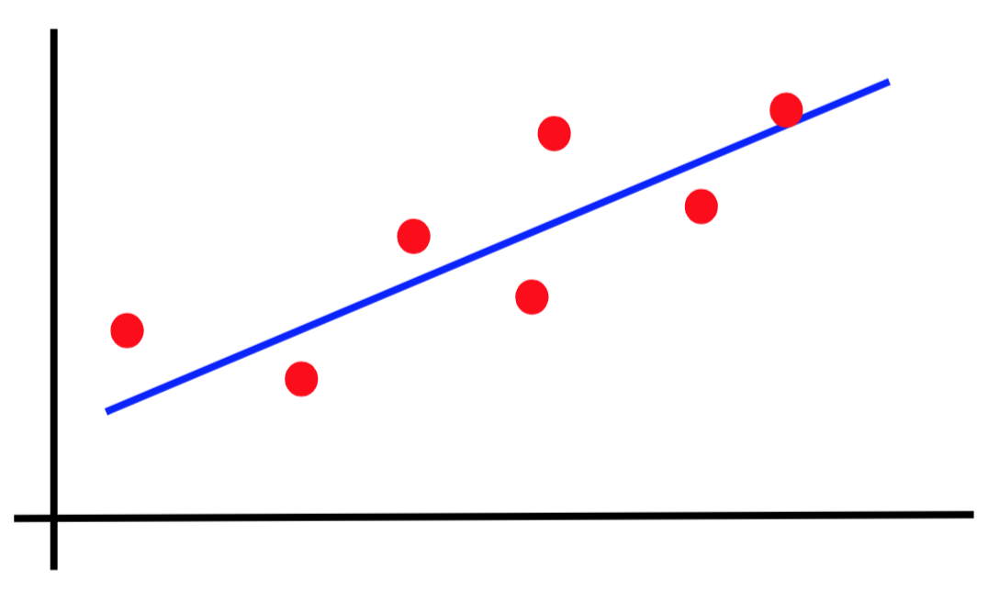
Canonical forms of supervised learning problems
Classification
Regression

Slide 8
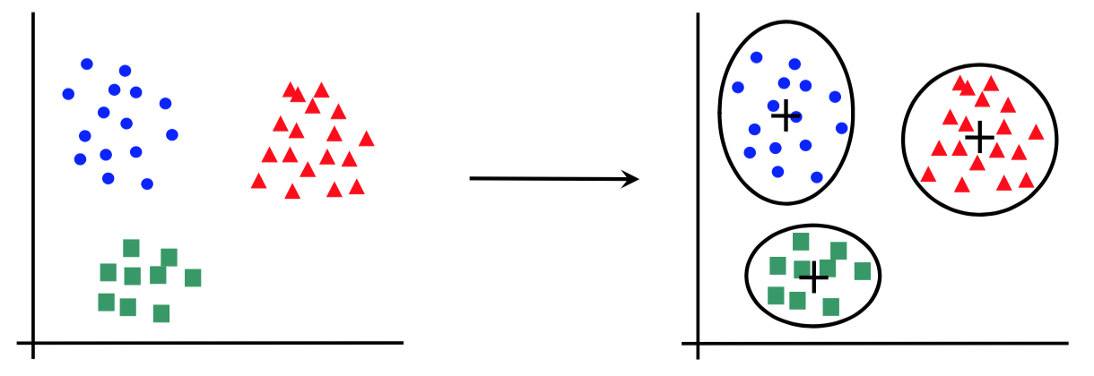
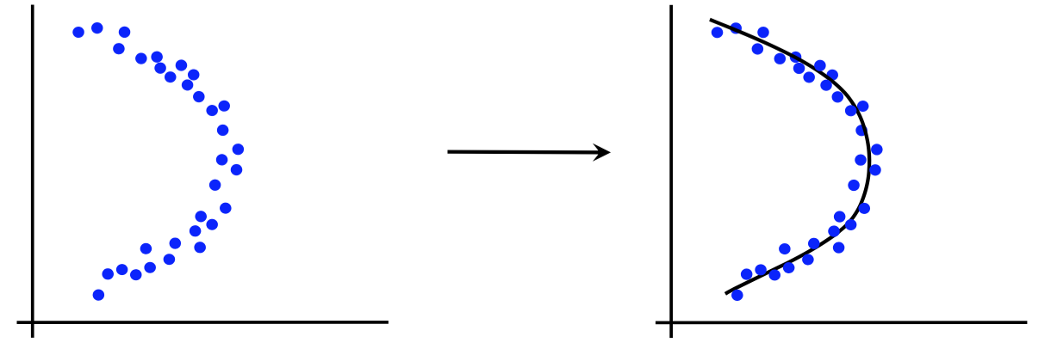
Canonical forms of unsupervised learning problems
Clustering
Dimensionality Reduction

Slide 9
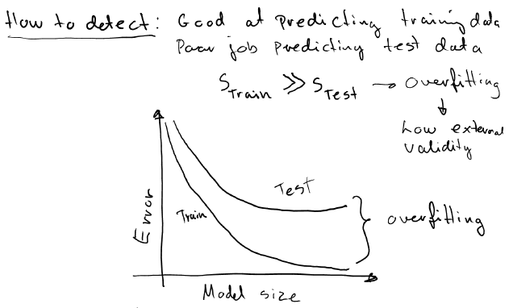


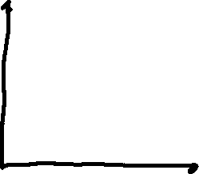



Slide 10
How Overfitting affects Prediction
Perhaps the most important problem of learning?
All about improving generalization capacity
Predictive Error
Error on Test Data
Error on Training Data
Model Complexity
Ideal Range
for Model Complexity
Underfitting
Overfitting

Slide 11
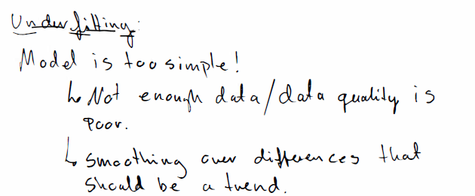
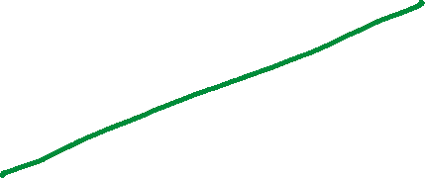

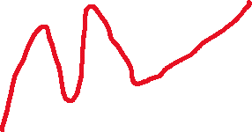

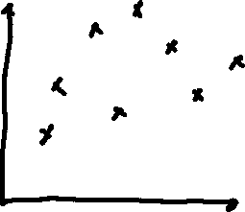



Slide 12
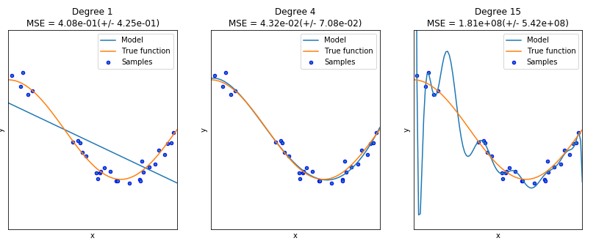
Overfitting and underfitting

Slide 13
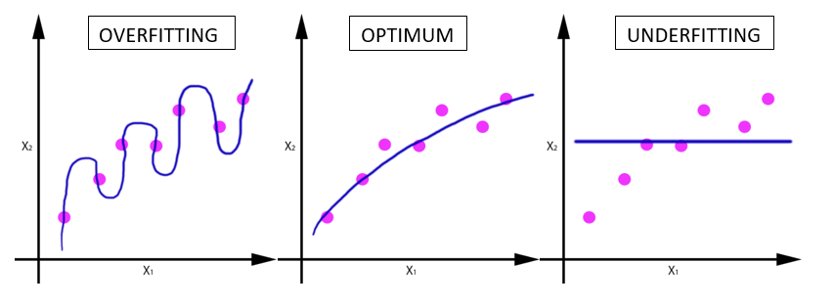
Underfitting versus overfitting
Example 1: regression task

Slide 14
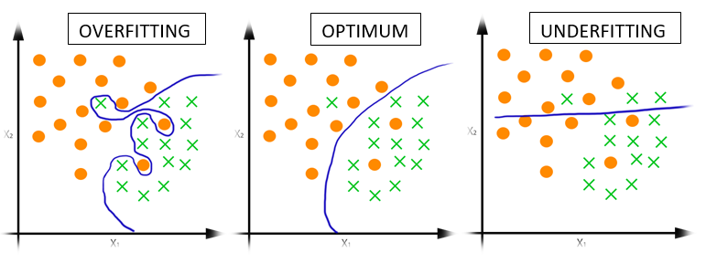
Underfitting versus overfitting
Example 2: classification task

Slide 15
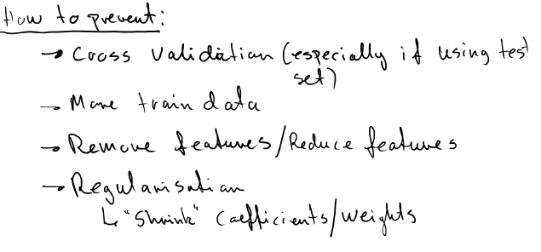

Slide 16
Splitting the data into
training and test
In order to build a model with good generalization capacity, we have to test it on unseen data
First approach (works well when we have enough data):
80% samples for training
20% samples for test
(percentages can vary)

Slide 17
Splitting the data into
training, validation and test
In order to build a model with good generalization capacity, we have to test it on unseen data
First approach (works well when we have enough data):
50% samples for training (or 64%)
25% samples for validation (or 16%)
25% samples for test (or 20%)
(percentages can vary)

Slide 18
Why not just split the data into
training and test?
Repeatedly using the same split when trying different hyperparameters can “wear out” the test set:
We are overfitting in hyperparameter space!
We obtain a better error estimate by tuning the hyperparameters on a (different) validation set

Slide 19
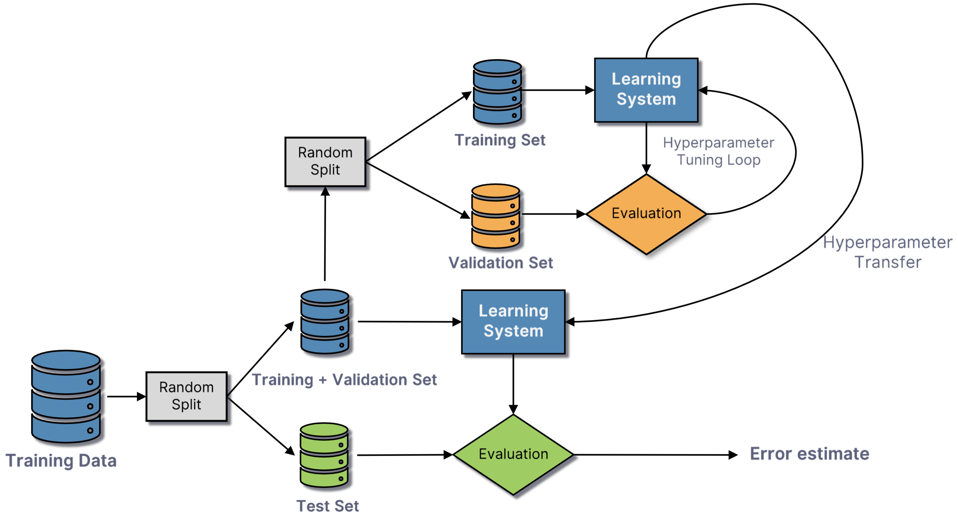
Training, validation, test

Slide 20
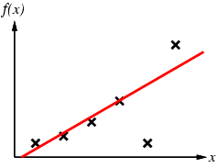
Inductive learning method
Construct/adjust h to agree with f on training set
(h is consistent if it agrees with f on all examples)
E.g., curve fitting:

Slide 21
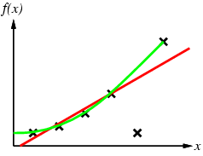
Inductive learning method
Construct/adjust h to agree with f on training set
(h is consistent if it agrees with f on all examples)
E.g., curve fitting:

Slide 22
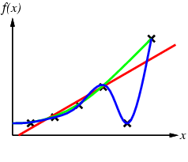
Inductive learning method
Construct/adjust h to agree with f on training set
(h is consistent if it agrees with f on all examples)
E.g., curve fitting:

Slide 23
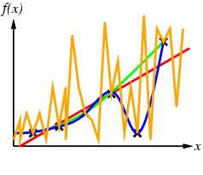
Inductive learning method
Construct/adjust h to agree with f on training set
(h is consistent if it agrees with f on all examples)
E.g., curve fitting:
Ockham’s razor: prefer the simplest hypothesis consistent with data

Slide 24
Generalization
24
Hypotheses must generalize to correctly classify instances not in the training data.
Simply memorizing training examples is a consistent hypothesis that does not generalize.
Ockham’s razor:
Finding a simple hypothesis helps ensure generalization.
Notes:
24

Slide 25
Illustrating Classification Task

Slide 26
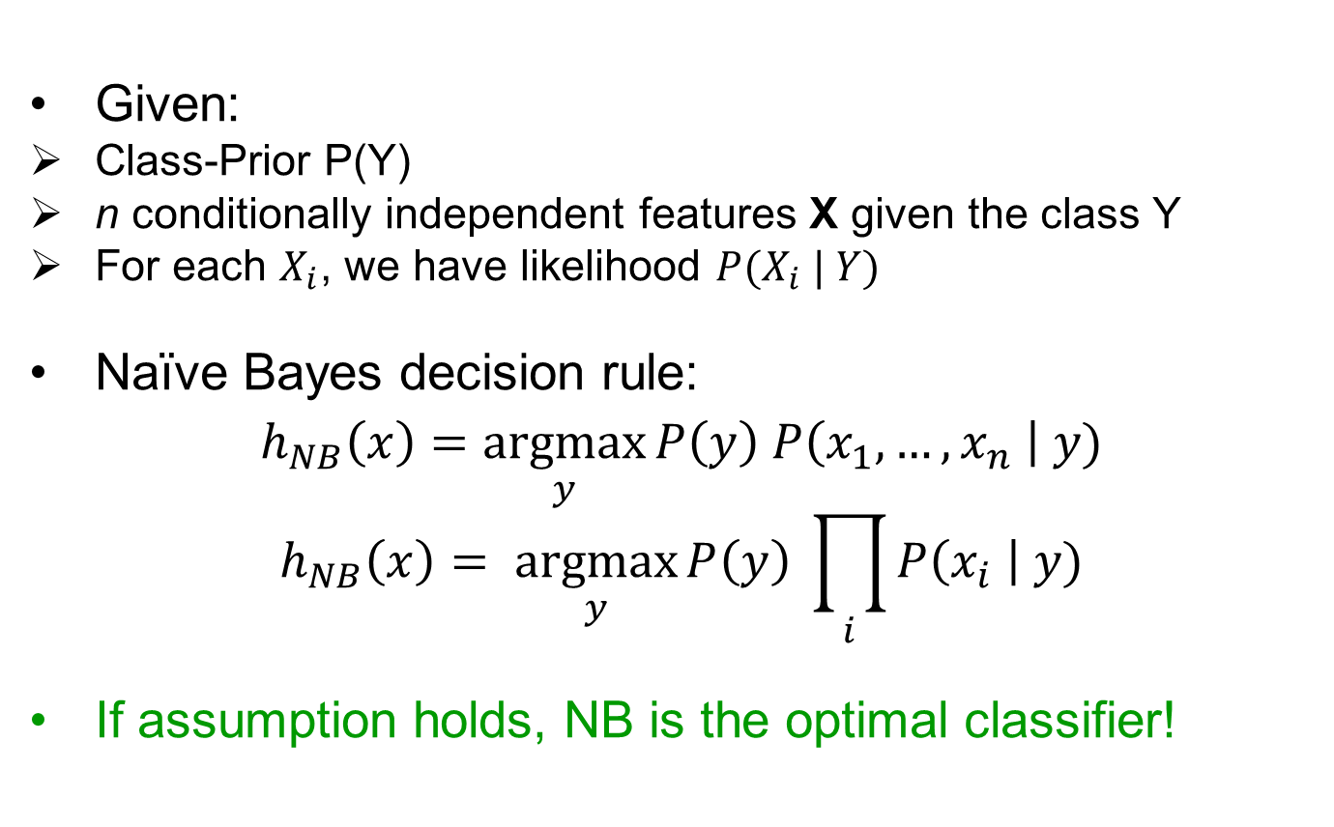
Naïve Bayes classifier
Given:
Class-Prior P(Y)
n conditionally independent features X given the class Y
For each $X_{i}$, we have likelihood ${P(X}_{i} | Y)$
Naïve Bayes decision rule:
$$h_{NB}\left(x\right)=\underset{y}{argmax}{P\left(y\right) P\left(x_{1},…,x_{n} \right| y)}$$
$$h_{NB}\left(x\right)= \underset{y}{argmax}{P\left(y\right) \prod_{i}{P\left(x_{i} \right| y)}}$$
If assumption holds, NB is the optimal classifier!

Slide 27
Nearest Neighbor Classifiers
Basic idea:
If it walks like a duck, quacks like a duck, then it’s probably a duck
Compute Distance
Test Record
Training Records
Choose k of the “nearest” records

Slide 28
Basic Idea
k-NN classification rule is to assign to a test sample the majority category label of its k nearest training samples
In practice, k is usually chosen to be odd, so as to avoid ties
The k = 1 rule is generally called the nearest-neighbor classification rule

Slide 29
Nearest-Neighbor Classifiers: Issues
The value of k, the number of nearest neighbors to retrieve
Choice of Distance Metric to compute distance between records
Computational complexity
Size of training set
Dimension of data

Slide 30
Value of K
Choosing the value of k:
If k is too small, sensitive to noise points
If k is too large, neighborhood may include points from other classes
Rule of thumb:
K = sqrt(N)
N: number of training points

